Slide 1

CSL-220: Database Management Systems Lab Lab # 04 Multiple Row Functions
Instructor: Engr. Hareem Fatima

Slide 2
SQL Multiple-Row Functions (Aggregate Functions)
Operate on multiple rows as a group.
Returns a single result for the entire group.
Used to perform calculations on groups of rows, often in conjunction with the GROUP BY and HAVING clauses of the SELECT statement.
Useful aggregate functions:
AVG() - Returns the average value
COUNT() - Returns the number of rows
MAX() - Returns the largest value
MIN() - Returns the smallest value
SUM()- Returns the sum

Slide 3
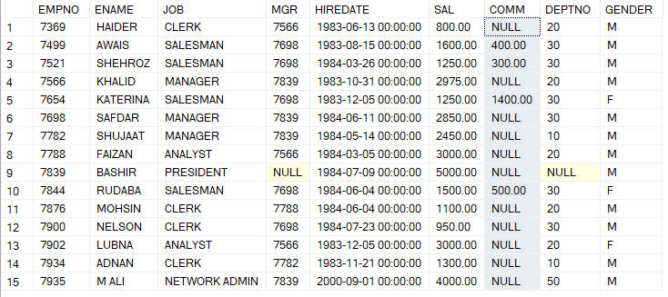



Examples
Select count(comm) from emp where deptno = 30;
Select avg(sal) AS AvgSalary,max(sal) AS MaxSalary, sum(sal) AS TotalSalary from emp where job like 'SALES%';
Select count(distinct(deptno)) AS numberofdepts from emp;

Slide 4



Difference ?
SELECT COUNT(*) FROM emp;
SELECT COUNT(DISTINCT DEPTNO) FROM emp;
SELECT COUNT(ALL DEPTNO) FROM emp;

Slide 5
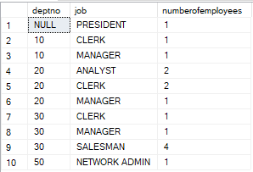
SQL GROUP BY
The SQL GROUP BY statement is used along with the SQL aggregate functions to organize rows with similar values in specific columns together, It's like putting similar items into categories, then performing calculations or aggregations on each group separately.
Example 1 : find number of employees against each job title in every department.
Select deptno, job, count(EMPNO/*)
as numberofemployees
from emp
group by job, deptno;

Slide 6
SQL GROUP BY
Example 2: We want to display the total salary being paid to each job title, within each department.
Try yourself ☺

Slide 7

SQL HAVING CLAUSE
The HAVING clause in SQL is used in conjunction with the GROUP BY clause to filter the results of a query based on aggregate conditions.
While the WHERE clause is used to filter individual rows before grouping, the HAVING clause is used to filter groups of rows after they have been grouped and aggregated.
Examples:
Find Departments with Total Salary Greater Than 10,000
SELECT DEPTNO, SUM(SAL) AS TotalSalary
FROM Emp
GROUP BY DEPTNO
HAVING SUM(SAL) > 10000;

Slide 8
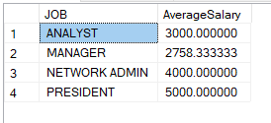
SQL HAVING CLAUSE
2. Show Jobs with Average Salary Above 2000
SELECT JOB, AVG(SAL) AS AverageSalary
FROM Emp
GROUP BY JOB
HAVING AVG(SAL) > 2000;
3. Show Jobs with More Than 2 Employees and Average Salary Above 2500.
Try yourself ☺

